Slide 1
Legal framework for trade and investments

Slide 2
Emerging Europe and Central Asia’s Leading Independent Law Firm
With offices in ten jurisdictions and 200 local and international lawyers, we deliver consistent, joined-up legal advice and assistance across diverse regional markets – together with the know-how and experience to champion your interests while minimising exposure to risk.
Bulgaria
Czech Republic
Hungary
Kazakhstan
Romania
Serbia*
Slovakia
Turkey
Ukraine
Uzbekistan

Slide 3
Our Expertise
Sectors | Practices
Aviation Automotive & Industrials Banks & Financial Institutions Energy Infrastructure Life Sciences & Healthcare Private Equity Real Estate Technology, Media & Telecommunications | Banking, Finance & Capital Markets Competition & State Aid Compliance, Risk & Sensitive Investigations Dispute Resolution Employment & Labour Law Energy Infrastructure & Projects Intellectual Property M&A & Corporate NPLs & Distressed Assets Real Estate, Construction & Planning Restructuring & Insolvency Tax Technology, Media & Telecommunications White-Collar Crime

Slide 4
Out of Area But certainly not out of our depth. Quite the contrary.
We have experience in coordinating external legal counsel in jurisdictions where we do not have a local presence. Kinstellar Prague would be your single point of contact in order to ensure the unified approach.
In case of any legal issues under Iceland law we are able to arrange a cooperation with a local law firm BBA.
BBA is a leading Iceland law firm (this is confirmed by the firm’s top tier ranking in the respective fields by all the major ranking companies), specialising in the area of mergers and acquisitions, capital markets, banking and corporate finance, bankruptcy law, PFI projects and general corporate and commercial law. Over the years BBA has advised, and continue to support, government, government-owned entities, local, regional and international companies, banks and financial institutions along with both international and regional law firms.

Slide 5
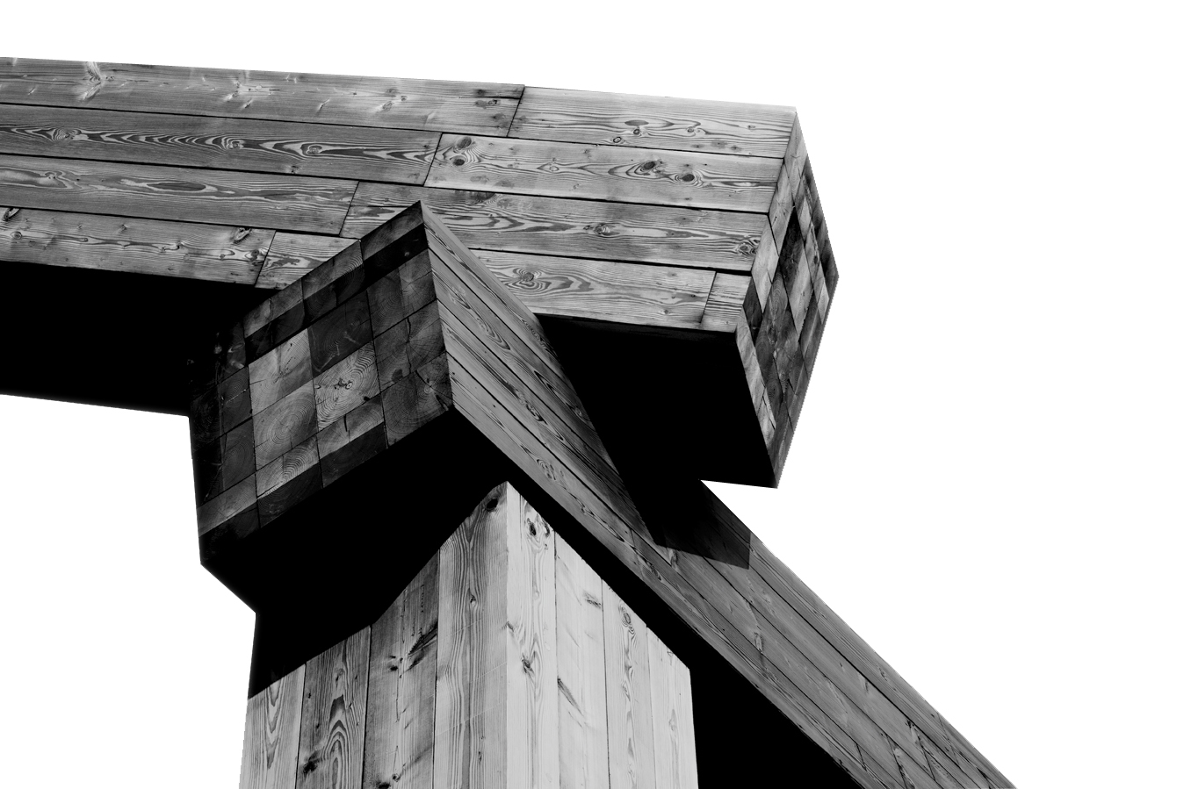
Running a Business in Iceland
Business and energy treaties in place
Enforcement of court judgments / arbitral awards
Use of official documents
How to start business in Iceland
Other issues to note
Notes:
In the course of this brief presentation we will try to answer or point out at least a couple of important legal questions which may be relevant when considering investing in Iceland. We have co-operated with our partner law firm ________in order to bring uptodate information.

Slide 6
International Treaties
Business and trade
EEA Agreement
Convention on the OECD
UN Convention on Contracts for the International Sale of Goods
Marrakesh Agreement establishing the World Trade Organisation
Convention establishing Multilateral Investment Guarantee Agency
ICSID Convention - Convention on the settlement of investment disputes between States and nationals of other States
Transport and logistic
Convention for the unification of certain rules for international carriage by air done at Montreal on 28 May 1999
Notes:
Agreement on the European Economic Area (Dohoda o EHP), which entered into force on 1 January 1994, brings together the EU Member States and the three EEA EFTA States — Iceland, Liechtenstein and Norway — in a single market, referred to as the "Internal Market".
Dohoda o Organizaci pro Hospodářskou spolupráci a rozvoj (OECD)
Vídeňská úmluva o mezinárodním prodeji zboží - The CISG is considered one of the core international trade law conventions whose universal adoption is desirable.
Agentura pro mnohostranné investiční záruky
Dohoda o zřízení Světové obchodní organizace podepsaná v marockém Marákéši
Celní úmluva o mezinárodní přepravě zboží v rámci karnetů TIR

Slide 7
International Treaties (Cont‘d)
Energy
Energy Charter Treaty
International Energy Forum Charter
Statute of the International Renewable Energy Agency (IRENA)
Statute of the IAEA
IP
Paris Convention for the Protection of Industrial Property
Member state of EPO
Member state of WIPO
Notes:
České názvy dohod:
Energy
Smlouva o energetické chartě
Charta mezinárodního energetického fóra
Nařízení Mezinárodní agentury pro obnovitelnou energii
Nařízení Mezinárodní agentury pro atomovou energii
IP
Pařížská úmluva o ochraně průmyslového vlastnictví
Členský stát Evropského patentového úřadu
Členský stát Světové organizace duševního vlastnictví

Slide 8
International Treaties
Finance
Convention for the Avoidance of Double Taxation and the Prevention of Fiscal Evasion with Respect to Taxes on Income (bilateral)
Convention concerning the simplification of formalities in trade in goods
Convention on a common transit procedure
Agreement of the IMF
Terrorism and Corruption
UN International Convention for the Suppression of the Financing of Terrorism
UN Convention against Corruption
Notes:
České názvy dohod:
Finance
Smlouva mezi ČR a Islandskou republikou o zamezení dvojího zdanění a zabránění daňovému úniku v oboru daní z příjmu
Úmluva o zjednodušení formalit ve zbožovém styku mezi Evropským hospodářským společenstvím a zeměmi Evropského sdružení volného obchodu /ESVO/
Úmluva o společném tranzitním režimu mezi zeměmi Evropského sdružení volného obchodu (ESVO) a Evropským hospodářským společenstvím
Dohoda o mezinárodním měnovém fondu
Terorismus a korupce
Mezinárodní úmluva o potlačování financování terorismu
Mezinárodní úmluva proti korupci

Slide 9
Enforcement of Decisions / Judicial Cooperation
Judgments in civil matters – ensured (both – recognition and enforcement)
Convention on jurisdiction and the recognition and enforcement of judgments in civil and commercial matters (The Lugano Convention, 21 December 2007)
Schengen Agreement
Judgments in criminal matters – only recognition and extradition are ensured
Convention on the Recognition and Enforcement of Foreign Arbitral Awards (New York, 1958)
Judicial Cooperation:
Convention of 15 November 1965 on the Service Abroad of Judicial and Extrajudicial Documents in Civil or Commercial Matters
Convention of 18 March 1970 on the Taking of Evidence Abroad in Civil or Commercial Matters
Convention of 1 March 1954 on civil procedure
The Schengen Agreement
Notes:
Iceland is a signatory country of The Lugano Convention which ensures that judgments in civil matters could be recognized and enforced.
Recognition and enforcement of foreign arbitral awards are guaranteed by New York Convention.
Iceland is a member state of Schengen and signed for example European Arrest Warrant, so this is the reason why extradition or judments in criminal matters are also ensured.
České názvy smluv:
Úmluva o příslušnosti a uznávání a výkonu soudních rozhodnutí v občanských a obchodních věcech (Luganská úmluva)
Úmluva o uznávání a výkonu cizích rozhodčích nálezů (Newyorská úmluva)
Schengenská dohoda
Haagská smlouva o doručování soudních a mimosoudních písemností v cizině ve věcech občanských a obchodních
Haagská smlouva o provádění důkazů v cizině ve věcech občanských a obchodních
Haagská úmluva o civilním řízení soudním

Slide 10
Verification of Documents / Apostille
Verification of Iceland documents for use in the Czech Republic
Ministry for Foreign Affairs of Iceland (Documents issued by judicial authority or notary)
Ministry of Justice of Iceland (Documents issued by administration)
Verification of Czech documents for use in Iceland
Ministry of Foreign Affairs of the Czech Republic (Documents issued by judicial authority or notary)
Ministry of Justice of the Czech Republic (Documents issued by administration)
Notes:
Haagská úmluva o apostile (Hague convention on apostille)
Article 1
The present Convention shall apply to public documents which have been executed in the territory of one Contracting State and which have to be produced in the territory of another Contracting State.
For the purposes of the present Convention, the following are deemed to be public documents:
a) documents emanating from an authority or an official connected with the courts or tribunals of the State, including those emanating from a public prosecutor, a clerk of a court or a process-server ("huissier de justice"); b) administrative documents; c) notarial acts; d) official certificates which are placed on documents signed by persons in their private capacity, such as official certificates recording the registration of a document or the fact that it was in existence on a certain date and official and notarial authentications of signatures.
However, the present Convention shall not apply:
a) to documents executed by diplomatic or consular agents; b) to administrative documents dealing directly with commercial or customs operations.

Slide 11
How to Start Business in Iceland?
Establishing a private limited company
ISK 130,500 = € 1,060
Minimum capital ISK 500.000 = € 4.000
Establishing a public limited company
ISK 256,000 = € 2,076
Minimum capital ISK 4.000.000 = € 32.400
Register a branch of a foreign company
Notes:
The most common and economically important type of business in Iceland is the limited company. Other structures are partnerships, cooperative societies, official limited companies, businesses run by the self-employed and branches of foreign limited companies.
Foreign public or private limited companies and companies in a corresponding legal form having legal domicile within the European Economic Area may engage in activities with the operation of a branch in Iceland. Corporate income tax: 20%.
It is fairly quick and simple to establish a limited liability company in Iceland. For example, when establishing a Private LLC, it is now possible to establish it electronically, and signing all the documents electronically, with the registration only taking 1-2 days. Generally, the time frame could differ from a few days to a few weeks depending on several factors, usually longer for a Public LLC than a Private LLC.
The typical cost of establishing a limited liability company is different for a Private LLC or a Public LLC. For a Private LLC, the cost of establishing is ISK 131,000 (approx. EUR 1,060) in addition to a minimum share capital of ISK 500,000 (approx. EUR 4,046). For a Public - 2 -
LLC, the cost of establishing is ISK 256,500 (approx. EUR 2,076) in addition to a minimum share capital of ISK 4,000,000 (approx. EUR 32,368).
Limited companies and branches are registered with the Internal Revenue in the Register of Enterprises division (Fyrirtækjaskrá).
The registration fee is approximate ISK 256,000 for a new public limited company and ISK 130,500 for a new private limited company.

Slide 12
Establishing a Company
Private Limited Company
May be founded by 1 or more persons – at least 1 entity must:
reside in Iceland or
be both a citizen and resident of an EEA or OECD country
Initial capital of at least ISK 500,000 = € 4,046
May be established via electronic means
Public Limited Company
Must have at least 2 founders – at least 1 of whom must:
reside in Iceland or
be a resident and citizen of an EEA or OECD country
Initial capital of at least ISK 4 million = € 32,434
Notes:
Private Limited Companies
Rules for private limited companies are simpler than for the public ones. The minimum stock required is ISK 500,000. Other minimum requirements are to have one founder, one shareholder, and one director (with one deputy) in cases where shareholders are four or less. There is no obligation to have a manager.
On their establishment, private limited companies must state whether they have one or more shareholders. In one-party private limited companies, meetings of the board of directors and shareholders are not obligatory.
The Minister of Commerce can grant an exemption from the otherwise general principle that the majority of the board of directors and the general manager of a limited company must be domiciled in Iceland or in a country within the European Economic Area or OECD.
Public Limited Companies
Public limited companies are mainly aimed at seeking capital from a wide number of shareholders among the public at large, for example on the stock market. The minimum stock required for a public limited company is ISK 4 million. Other minimum requirements are that the company has two founders, two shareholders, three directors on the board of directors, and a manager. The provisions on branches are similar for both public and private limited companies, except that disclosure requirements for the Register of Enterprises are somewhat stricter with respect to public limited companies.
Number of Founders
A public limited company must have at least two founders, at least one of whom must reside in Iceland or be a resident and a citizen of an EEA or OECD country. A private company may be founded by one or more persons. At least one entity must reside in Iceland or be both a citizen and resident of an EEA or OECD country.

Slide 13
Restrictions on foreigners owning shares / real estate
Foreign ownership of business – unrestricted, except certain areas (fishing, aviation, energy)
The manager + at least half of the Board of Directors remain residents of Iceland, of another EEA country, or of any other OECD country
Real estate - restrictions under the Property Act
LL for the company‘s debts, the company shall have its domicile and venue in Iceland
All directors
Icelandic citizens or
domiciled in Iceland for at least 5 years
Notes:
In general, foreign ownership of businesses in Iceland is unrestricted despite some limitations relating to specific sectors, such as fishing, energy and aviation, that should be noted. However, apart from the fishing industry, these restrictions do not apply to EEA parties.
An EEA party, as well as a non-EEA party, can acquire the shares of an Icelandic company without any specific legal hindrances. However, it is required that the manager and at least half of the Board of Directors of the acquired Icelandic company remain residents of Iceland, of another EEA country, or of any other OECD country.
There are restrictions in place regarding the investment in real estate in Iceland according to the Property Act. The Act places restrictions on who can acquire or have the right to own or use real estate in Iceland. When the purchaser of real estate is a company whose shareholders have limited liability for the company’s debts, the company shall have its domicile and venue in Iceland. Further, all its directors shall be Icelandic citizens or shall have been domiciled in Iceland for at least five continuous years.
Furthermore, at least 80% of the share capital shall be owned by Icelandic citizens, and Icelandic citizens shall exercise majority of the votes at shareholder meetings. Due to the free movement of capital within the EEA area, EEA citizens enjoy the same rights as Icelandic citizens in this regard.
The Ministry of Interior may grant exemptions, from the above conditions, to acquire real estate in two scenarios:
a) in accordance with an application from a party who has the right to conduct business in Iceland and wishes to acquire the right to own or use real property in direct connection with his business activities or to establish a home on the property;
b) or if other reasons are considered to apply.

Slide 14
Debt financing and typical security package
LMA standard for large deals
Pledges: Act on Contractual Pledges
2 categories of assets:
subject to public registration requirements
not subject to any registration requirements
floating charges, possessory and non-possesory pledges are possible
Notes:
Debt financing is common in Iceland. However, it is not necessarily nor typically based on LMA standard unless for the larger financing deals. Examples of common financing in Iceland include bank loans, bond issuing or having a line of credit. Usually, a security would have to be provided as well as covered below.
The typical set of security package differs of the type of debt financing in question. The taking of pledges and how pledges are perfected is mainly governed by Act on Contractual Pledges and certain general principles of law. The taking of security differs between the type of assets that are intended to be pledged as security and the assets can broadly be grouped into two categories: assets that are subject to public registration requirements, e.g. real property, vehicles and vessels, and assets that are not subject to any registration requirements.
It is also possible to categorize the pledges by their types for example: i) non-possessory pledges, ii) possessory pledges and iii) floating charges. The type to be used depends on the type of assets and the intention of the pledgee or pledgor. Same applies to the registration and perfection requirements and the enforcement procedure, which differs depending on the relevant pledge in question.

Slide 15
Exchange Control or Currency Regulations?
Since 14 March 2017 most restrictions on foreign exchange transactions and cross-border movement of domestic and foreign currency have been lifted.
Some financial protections remain in place (e.g. reserve requirements for special investments to new inflows of foreign currency)
Free convertibility to any foreign currencies

Slide 16
BITs
No BIT in place, only ICSID Convention and Energy Charter Treaty protection
Convention for the Avoidance of Double Taxation and the Prevention of Fiscal Evasion with Respect to Taxes on Income
Agreement concerning the abolition of visas
Notes:
České názvy smluv:
Smlouva mezi ČR a Islandskou republikou o zamezení dvojího zdanění a zabránění daňovému úniku v oboru daní z příjmu
Dohoda mezi vládou České a Slovenské Federativní Republiky a vládou Islandské republiky o zrušení vízové povinnosti sjednaná výměnou nót

Slide 17
Questions?
?
? ? ? ? ? ? ? ? ? ? ? ? ? ? ? ? ? ? ? ? ? ? ? ? ? ? ? ? ? ? ? ? ? ? ? ? ? ? ? ? ? ? ? ? ? ? ? ? ? ? ? ? ? ? ? ? ?

Slide 18
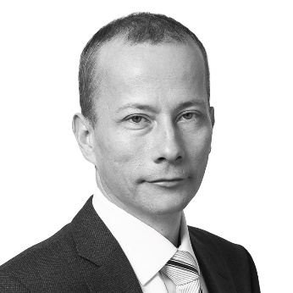
Thank You!
Kamil Blažek
Partner
+420 221 622 160
kamil.blazek@kinstellar.com
We would be pleased to provide you with any further information about any of our offices, lawyers, practice areas or expertise (as well as our fees policy) which you might require. Should you have any questions, all contact information is available on: www.kinstellar.com

