Slide 1
Romania
4th September 2018

Slide 2
Romania
Mr. Karel Machotka
Executive Director of ICC Czech Republic
4th September 2018

Slide 3
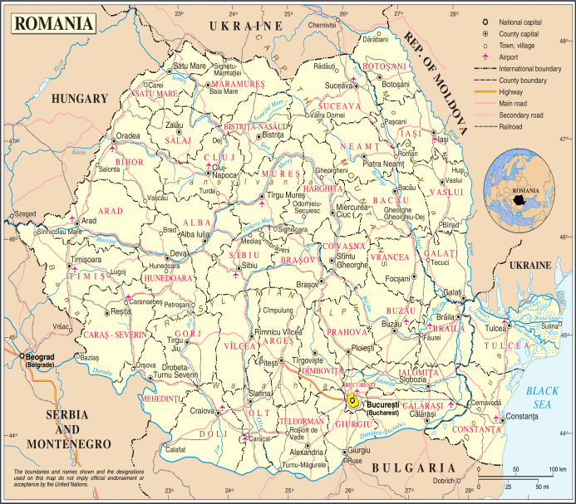
Romania
GDP (PPP, 2017 est.): $ 481.5 billion
GDP per capita (PPP, 2017 est.): $ 24,500
Export
Composition of GDP (2017 est.)
Partners (2017): Germany 23 %, Italy 11.2 %, France 6.8 %, Hungary 4.7 %, UK 4.1 %
Commodities (2017): machinery and equipment, other manufactured goods, agricultural products and food stuffs, metals and metal products, chemicals, minerals and fuels,
raw materials
Import
Partners (2017): Germany 20 %, Italy 10 %, Hungary 7.5 %, Poland 5.5 %, France 5.3 %, China 5 %, Netherlands 4 %
Commodities (2017):machinery and equipment, other manufactured goods, chemicals, agricultural products and foodstuffs, fuels and minerals, metals and metal products, raw materials
Ratings
OECD Country Risk Classification (6/2018): 3/7
Global Competitiveness Index (2017-2018): 68/137
Doing Business (2018): 45/190
Sources: *CIA Factbook, **OECD, Reports.webforum.org, Tradingeconomics.com, Imd.org, DoingBusiness.org ***BusinessInfo.cz

